Slide 1
Building Decision Models in R
Notes:
Eline

Slide 2
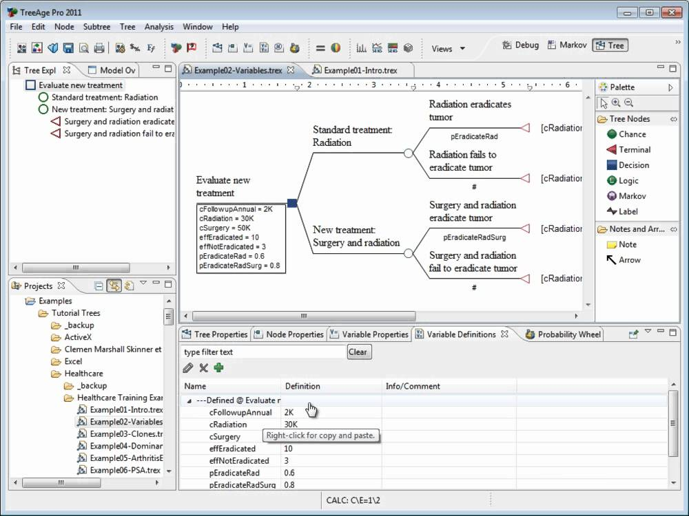

Slide 3
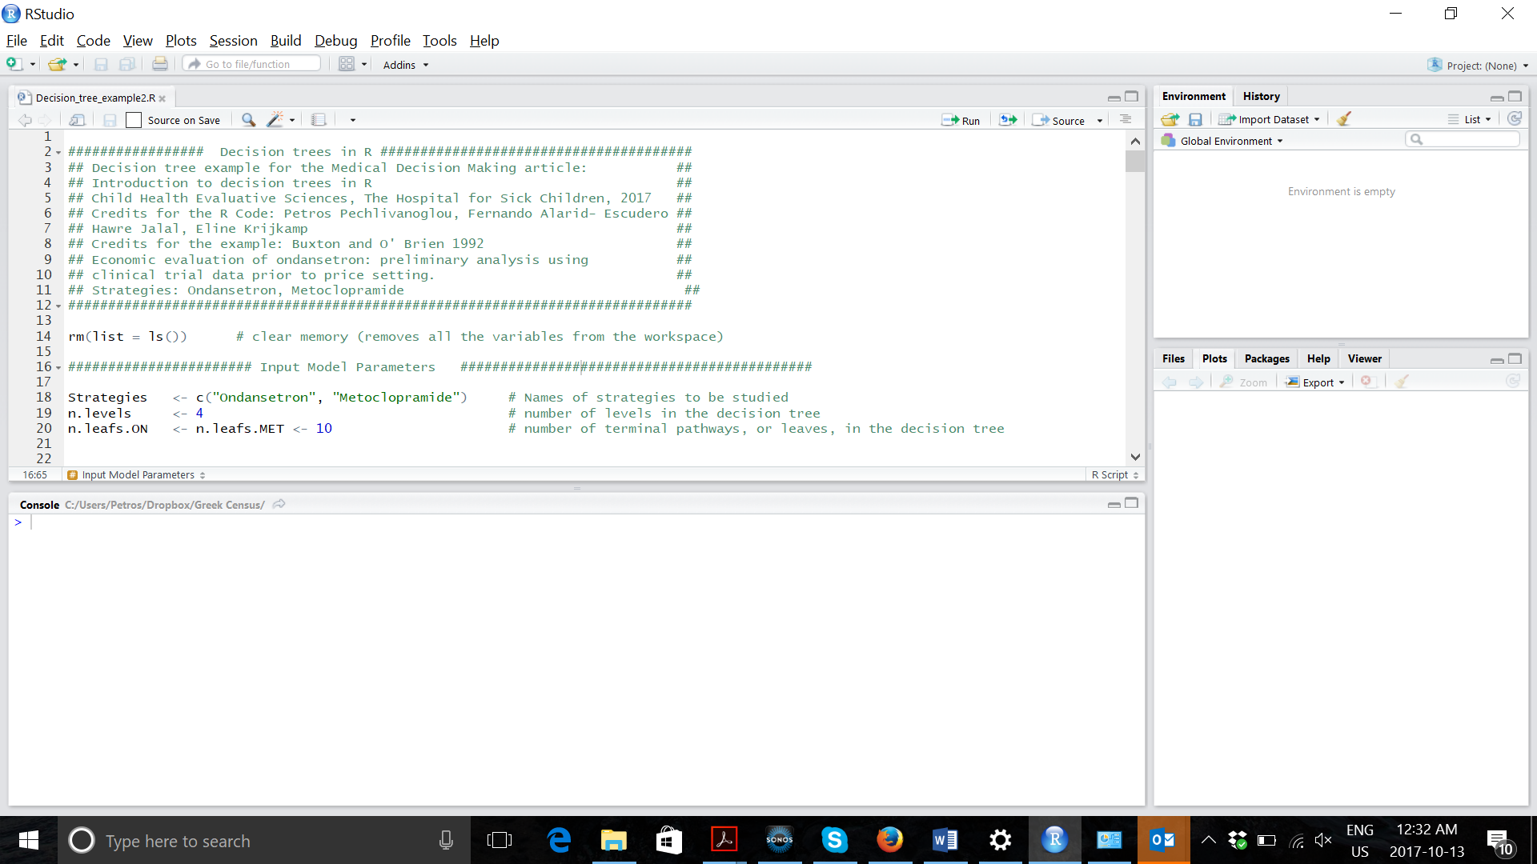

Slide 4
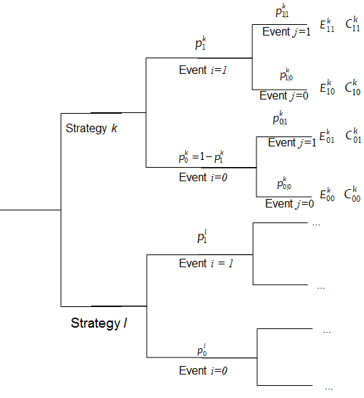
The Decision Tree

Slide 5

Inputting data in R
Input
: Probability of an event i in treatment k.
: Conditional probability of event j given event i in treatment k.
: Effectiveness associated with experiencing the combination of events i and j in treatment k.
: Costs associated with experiencing the combination of events i and j in treatment k.

Slide 6
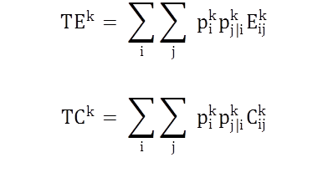
Conceptualizing a decision tree
Initialize total effects (TE), total costs (TC) vectors containing the total effectiveness and costs for all k strategies
The expected effectiveness and cost for each intervention can be described with one single equation

Slide 7

Conceptualizing a decision tree
Output
Incremental Costs: ΔC_{kl} = TC_{l} – TC_{k}
Incremental Effects: ΔΕ_{kl} = TE_{l} – TE_{k}
Incremental Cost Effectiveness Ratio:
ICER_{kl} =
Create graphical representations of the results (CE planes etc)

Slide 8
Example Decision Tree
Estimating the cost-effectiveness of three follow-up practices for colorectal cancer after colorectal cancer treatment (Gray et al, 2011).
Follow-up in primary care (PC),
Follow-up in hospital care (HC) or
Continue routine practice (RP).
Strategies are different on:
Probability of early detection (ed) vs late detection (ld) of recurrence of colorectal cancer
Follow-up costs (C) in UK pounds
Differences in early detection rates are associated with life expectancy (LE)

Slide 9
Decision Tree Example
Parameters | Variable Name in R | value
Probability of early detection
Follow-up in primary care (PC) | p_PCed | 0.40
Follow-up in hospital care (HC) | p_HCed | 0.45
Routine practice (RP) | p_RPed | 0.35
Life expectancy (Years)
Early detection | le_ed | 7
Late detection | le_ld | 1
Total healthcare costs (Follow-up and treatment - $)
Early detection in PC | c_PCed | 3900
Early detection in HC | c_HCed | 6200
Early detection in RP | c_RPed | 3030
Late detection in PC | c_PCld | 12800
Late detection in HC | c_HCld | 14400
Late detection in RP | c_RPld | 12020

Slide 10
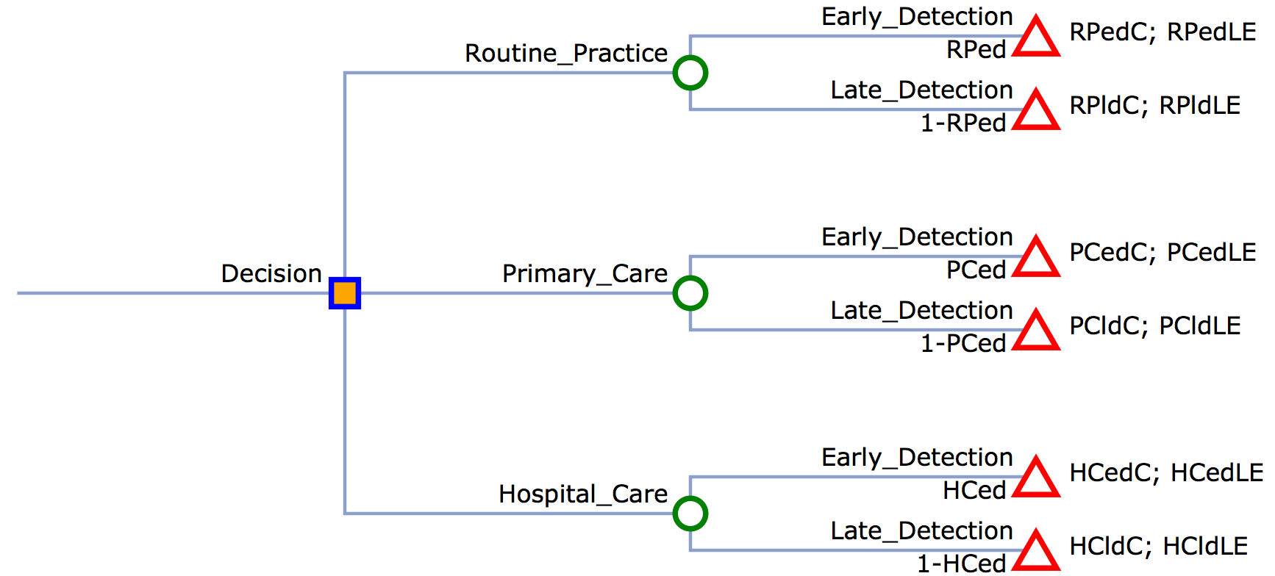
Example Decision Tree
c.RPed; e.RPed
c.RPld; e.RPld
c.PCed; e.PCed
c.PCld; e.PCld
c.HCed; e.HCed
c.HCld; e.HCld
Decision tree made in myopenTree.com

Slide 11
R Session
Notes:
Part 1 = Showing code 3 state model
Part 2 = Exercise build Sick-Sicker model
Part 3 = Show answers of Sick-Sicker

